Slide 1
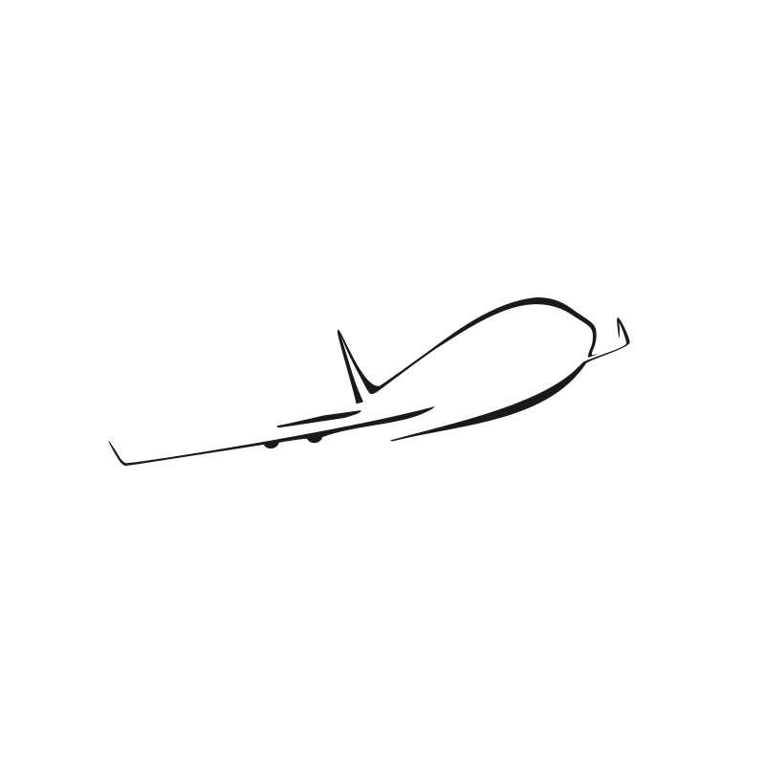
CSC380 – Airplane Application
Andrew Spano, Jimmy Nguyen, Zachary Gudlin

Slide 2
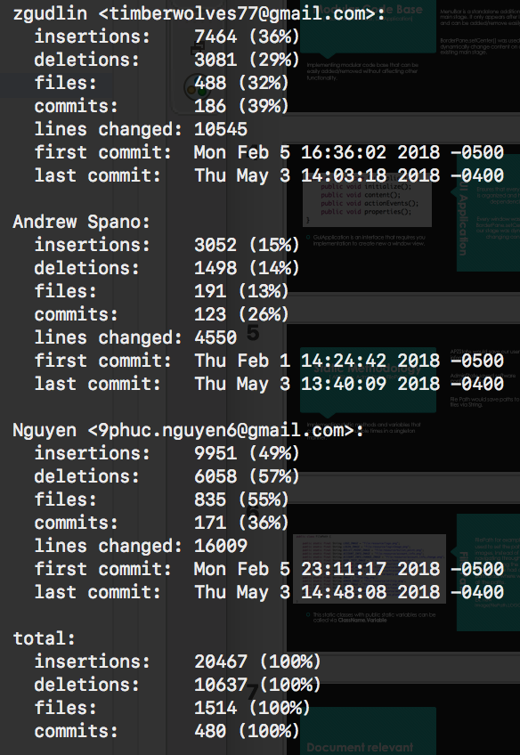
Team Members Andrew Spano Jimmy Nguyen Zachary Gudlin
Contributions:

Slide 3
Modular Code Base [ Launcher, MenuBar, GuiApplication]
Implementing modular code base that can be easily added/removed without affecting other functionality.
GuiApplication is an interface for creating windows.
MenuBar is a standalone addition to our main stage. It only appears after login and can be added/remove easily.
BorderPane.setCenter() was used to dynamically change content on our existing main stage.

Slide 4
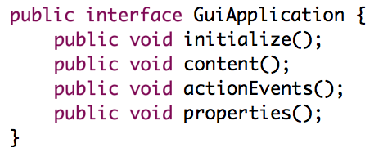
GUI Application
Ensures that every window is organized and has all its dependencies.
Every window was set with BorderPane.setCenter(); so our stage was dynamically changing content.
GuiApplication is an interface that requires you implementation to create new a window view.

Slide 5
Static Methodology [ APZState, AdminState, FilePath]
Implementing static methods and variables that can be accessed multiple times in a singleton manner.
APZState would save our user information.
AdminState saved software configured files.
File Path would save paths to files via String.

Slide 6
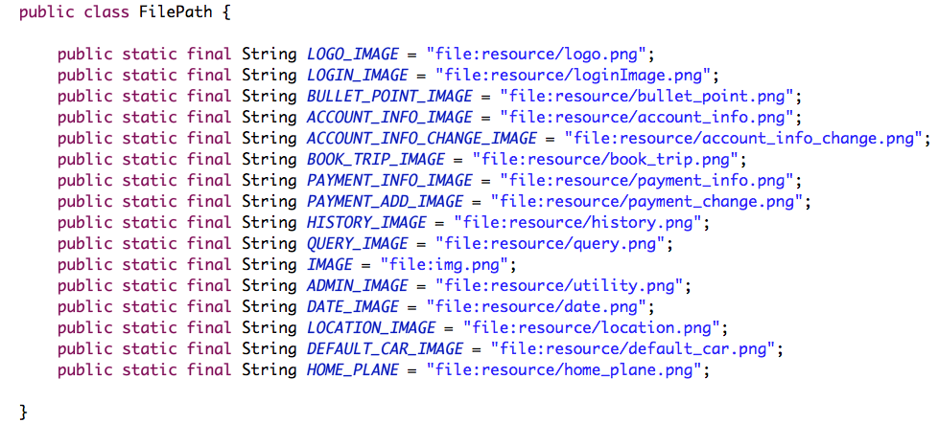
File Path
FilePath for example was used to set the path for images. Instead of navigating through code and changing the path if need be, we had a file path class where we stored all the paths.
Ex. new Image(FilePath.LOGO_IMAGE);
GuiApplication is an interface that requires you implementation to create new a window view.

Slide 7
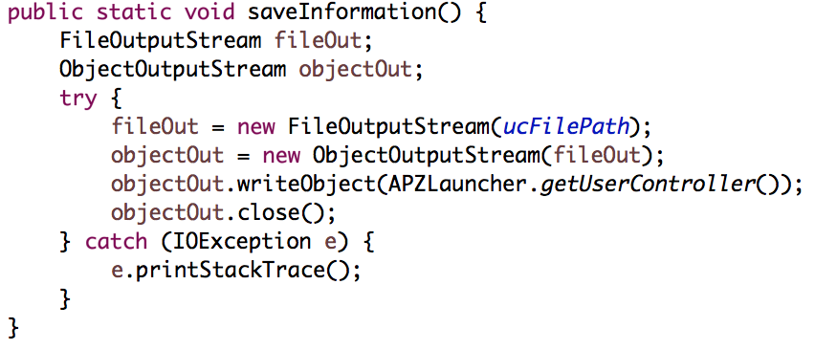
APZState
If a save state had to be called, it would be done so via APZState.saveInformation();
This was thought of in regards to the Singleton pattern but it did not have to exist as an object or store objects so Singleton was not used.
APZState had static methods to save and load in files.

Slide 8
Document relevant parts

